Slide 1
Credit Scoring & Predicting Default Probability
Liangxiao Li, Troy Campbell, Asiyah Sharif, Jemma Moseley, Binghan Shang

Slide 2
What is Default Probability?
Probability a borrower is unable to pay back a debt within a given time
Links directly to individual’s credit score
Crucial information for lenders
Especially important in current times

Slide 3
The task
Dataset with 150,000 entries and 10 variables which include relevant information about individual
For example: Monthly income, Number of Dependents etc
Develop statistical model to predict default probability
Determine which attributes/features are more useful in prediction

Slide 4
The pipeline
Original data
Cleaned dataset
Data imputation
PCA
Model fitting
Model evaluation

Slide 5
ORIGINAL DATA
MISSING VALUES
Monthly Income contained 29,731 NA entries which was 19.82% of the data
Number Of Dependents contained 3,924 NA entries which was 2.62% of the data
Not sufficient to remove all missing values, therefore imputation is necessary.
IMBALANCE OF DATASET
Total default entries = 10,026 (6.68%)
Total non-default entries =139,974 (93.32%)

Slide 6
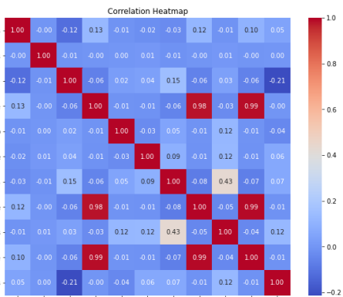
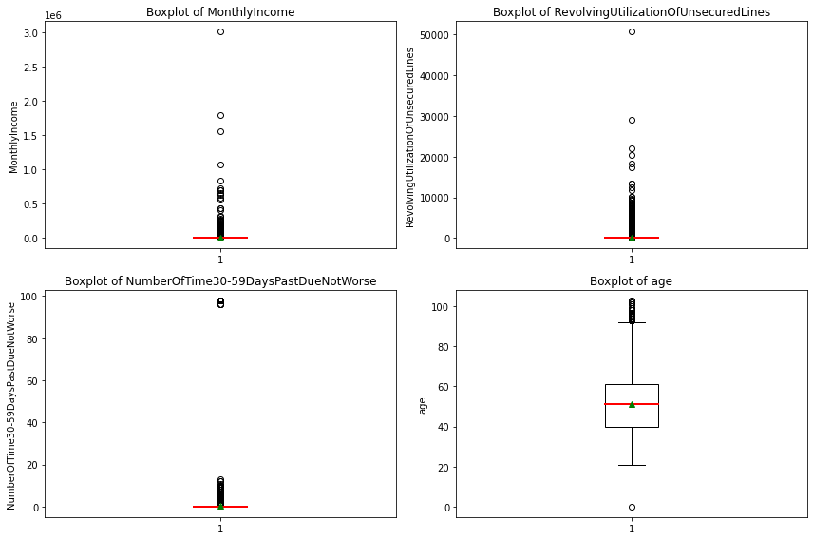

Slide 7
ORIGINAL DATA
OUTLIERS
Monthly Income and Past Due Variables have extreme outliers.
Other variables have outliers that seem more appropriate.
CORRELATION
The Past Due Variables are 0.99 correlated, all other variables have little to no correlation.
Correlation and Extreme Outliers can be a source of concern due
to our model assumptions

Slide 8
The pipeline
Original data
Cleaned dataset
Data imputation
PCA
Model fitting
Model evaluation

Slide 9
Data Cleaning
DATA CONSTRAINTS
Age: Between 18 and 75
Monthly Income: 0 or greater than the Minimum Income
Debt Ratio: Less than 2
Revolving Utilisation: Less than 6
In data cleaning. we had to also consider illogical data.
In the context of credit scoring, illogical data can be determined by standard bank regulations and the law.
We applied these restrictions first and adjusted the severity of them to balance the removal of outliers while preserving a sufficient dataset for the analysis.

Slide 10
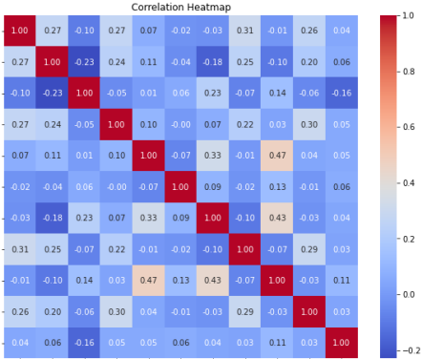
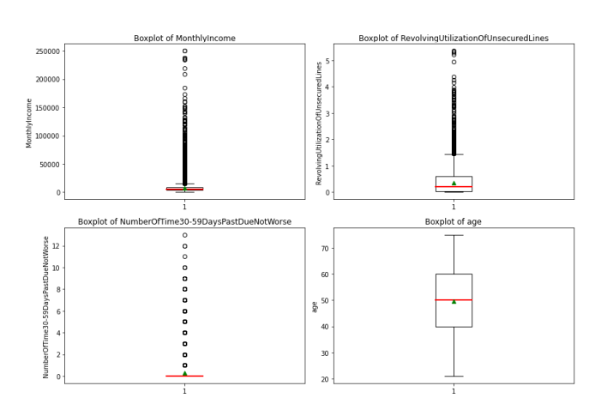

Slide 11
CLEANED DATASET
MODIFIED BOXPLOTS
No Extreme Outliers
MODIFIED CORRELATION
All variables have little to no correlation.
When cleaning the dataset, we had to balance the removal of outliers while preserving a sufficient dataset for the analysis.
This final dataset has retained 86.1% of the original, we deemed this a reasonable amount and moved to the next step.

Slide 12
The pipeline
Original data
Cleaned dataset
Data imputation
PCA
Model fitting
Model evaluation

Slide 13
Imputation – Overview
Variable | Number of NA’s
SeriousDlqin2yrs (0/1) | 0
MonthlyIncome | 29731
NumberOfDependents | 3924
SD: 0
MI:29731
NOD:3924
Notes:
Do we need this slide, as in slide 5 we mention NA values

Slide 14
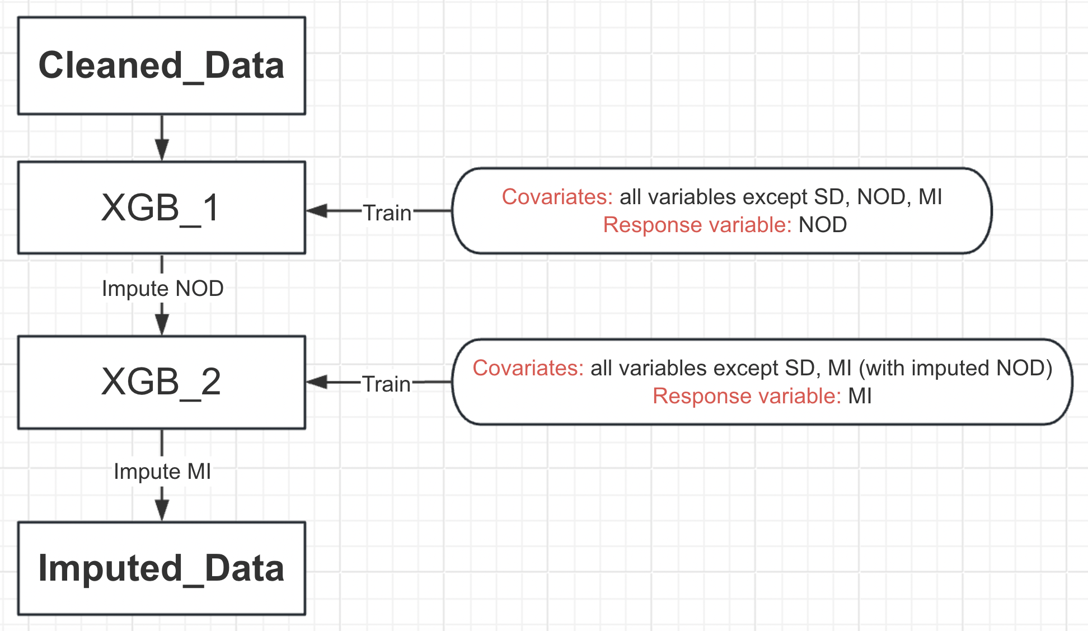
Imputation – Pipeline
SD: Target
MI:29731
NOD:3924

Slide 15
Imputation – Result
 | Imputed NOD |  |  | Imputed MI
 | MSE | MAE | R² | MSE | MAE | R²
Mean | 1.35 | 0.94 | 0 | 0.52 | 0.53 | 0
Median | 2.14 | 0.89 | -0.58 | 0.52 | 0.53 | -0.01
GBDT | 1.15 | 0.831 | 0.16 | 0.36 | 0.38 | 0.42
XGB | 1.14 | 0.83 | 0.161 | 0.33 | 0.36 | 0.46
eXtreme Gradient Boosting
XGB: Industry level ML Algorithm

Slide 16
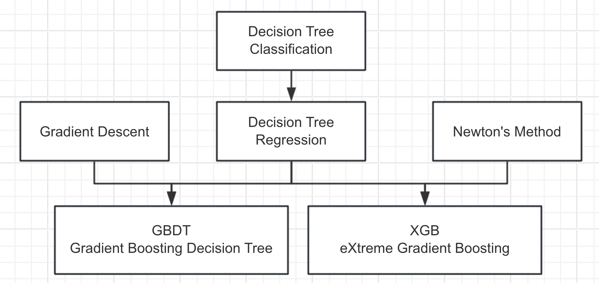
Imputation – XGB Model
Proof omitted!
3
1
4
2
5
6

Slide 17
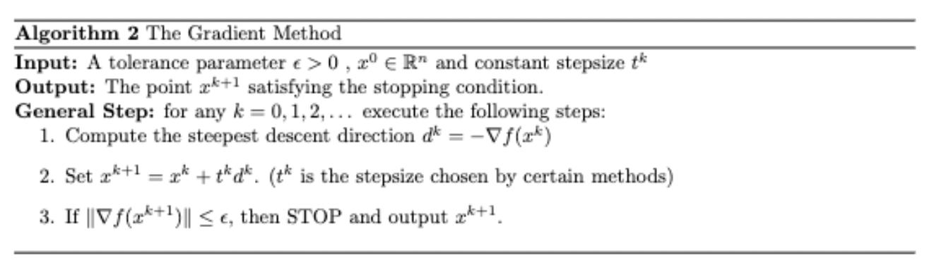
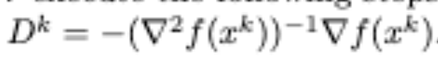
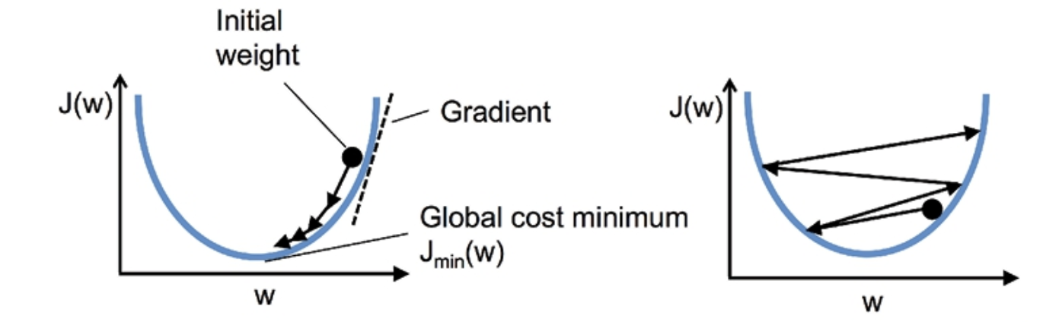

Imputation – Gradient Descent/Newton’s Method
$$n$$
Newton’s Direction
x
x
x

Slide 18
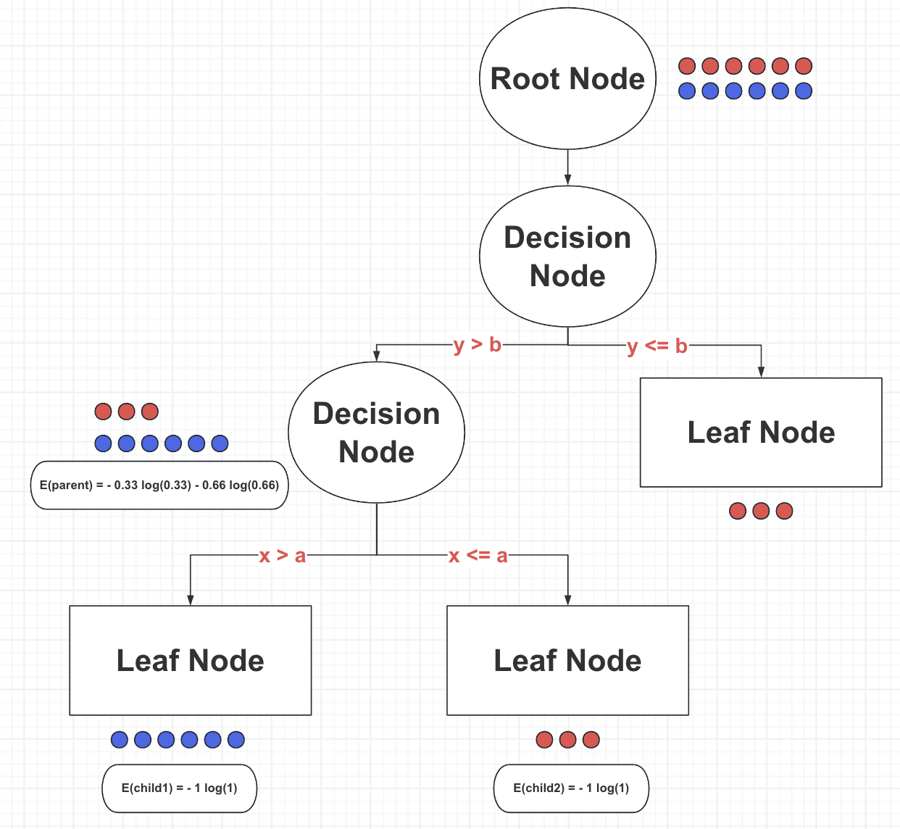
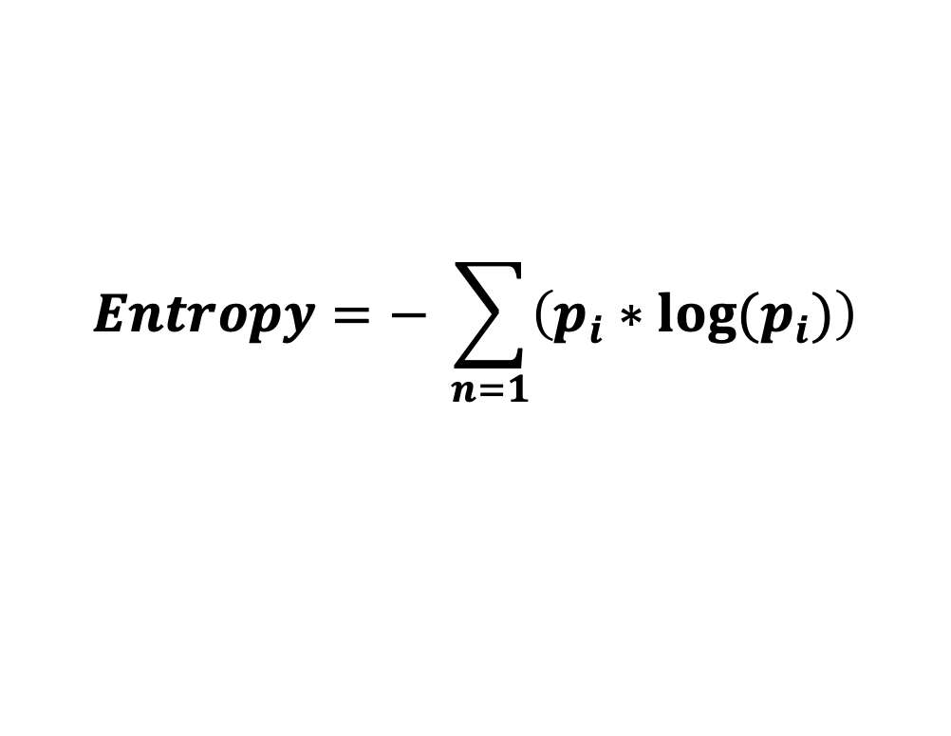
Imputation – Decision Tree Classifier
$$n$$
How to find split condition?
$$Entropy=− \sum_{n=1}{\left(p_{i}∗log⁡(p_{i})\right)}$$

Slide 19
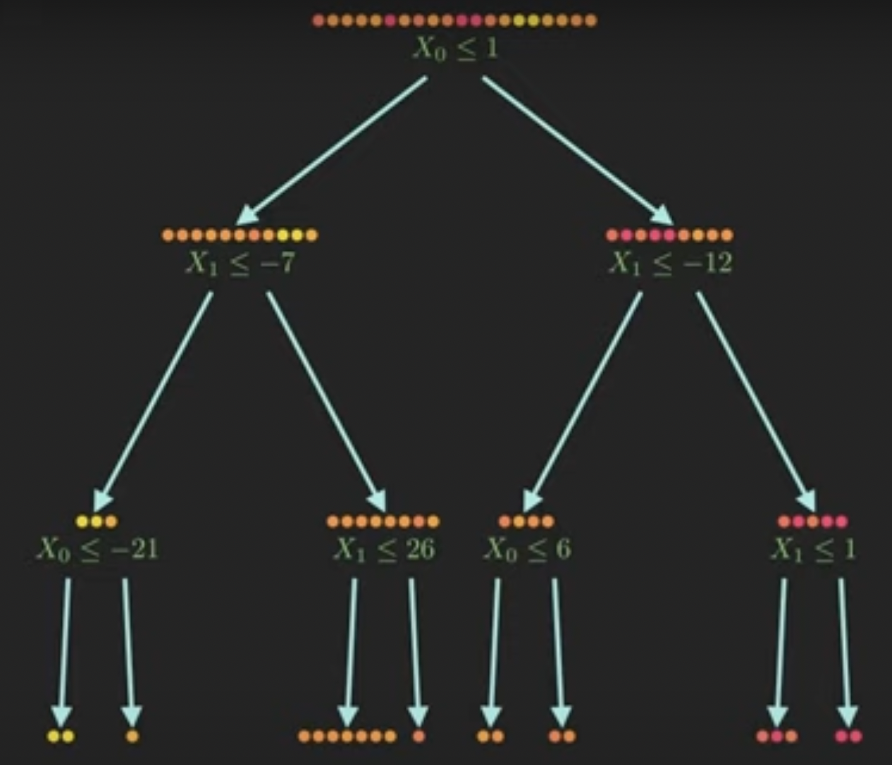
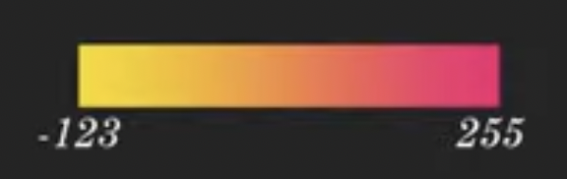
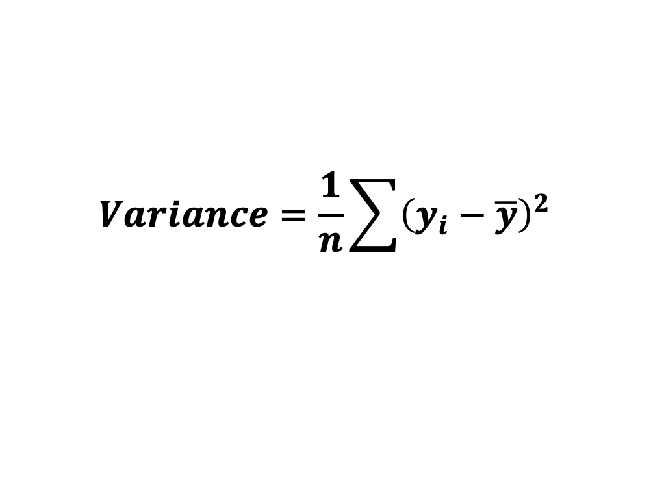
Imputation – Decision Tree Regressor
$$n$$
How to find split condition?
$$Variance=\frac{1}{n}\sum{{\left(y_{i}−\overline{y}\right)}^{2}}$$

Slide 20
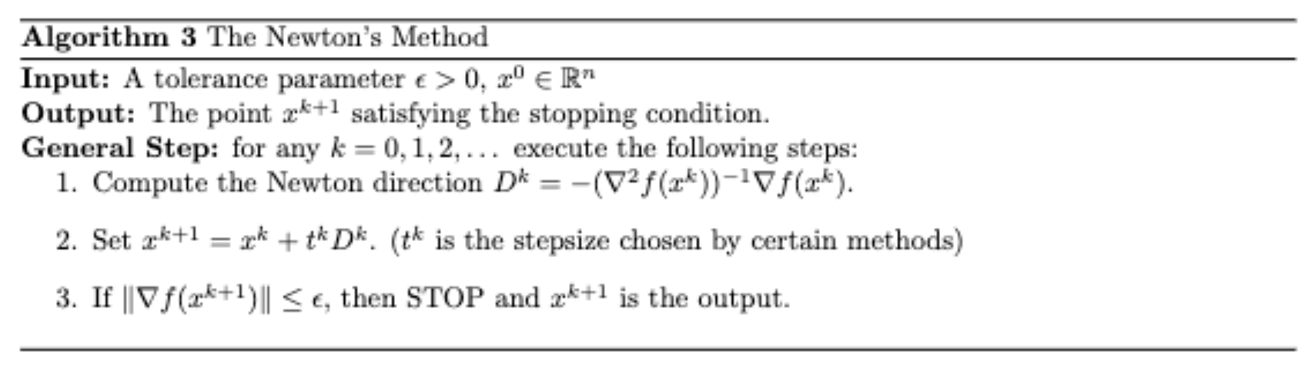
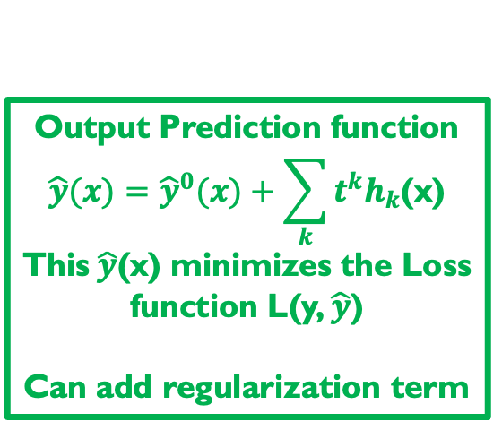
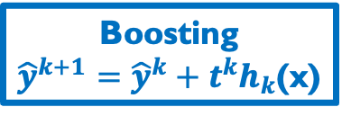

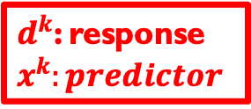
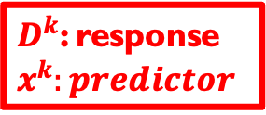
Imputation – GBDT & XGB
$$n$$
$d^{k}$: response
$$x^{k}:predictor$$
Decision Tree
$$h_{k}(x)$$
Boosting
${\hat{y}}^{k+1}={\hat{y}}^{k}+t^{k}h_{k}$(x)
Output Prediction function
$$\hat{y}(x)={\hat{y}}^{0}(x)+\sum_{k}{t^{k}h_{k}\text{(}\text{x}\text{)}}$$
This$\hat{y}$(x) minimizes the Loss function L(y, $\hat{y}$)
Can add regularization term
$D^{k}$: response
$$x^{k}:predictor$$

Slide 21
The pipeline
Original data
Cleaned dataset
Data imputation
PCA
Model fitting
Model evaluation

Slide 22
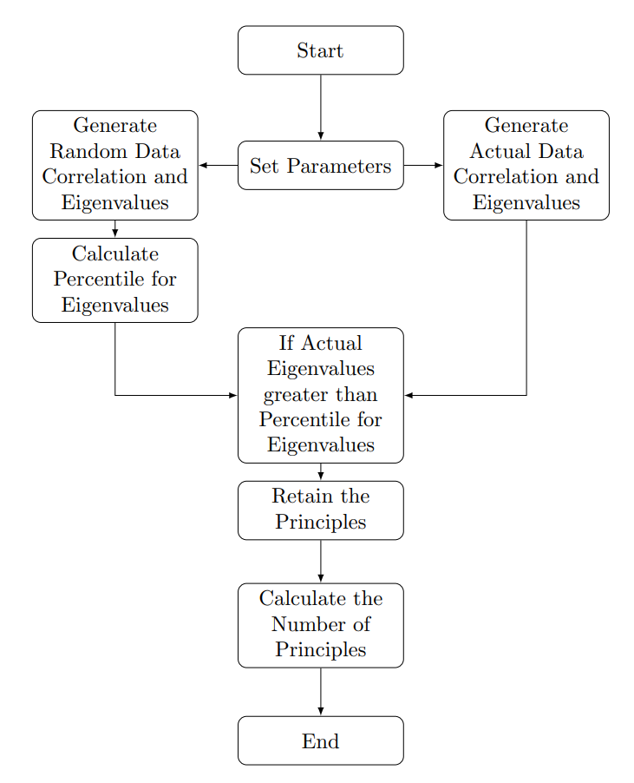

PCA – PARALLEL ANALYSIS
$$n$$
Principal Component Analysis(PCA) is a multivariate method used to analyze datasets with correlated variables.
Use parallel analysis to determine the optimal number of components to retain.
Retain components if the actual eigenvalues > 95th percentile for eigenvalues of random data
Process of Parallel Analysis

Slide 23
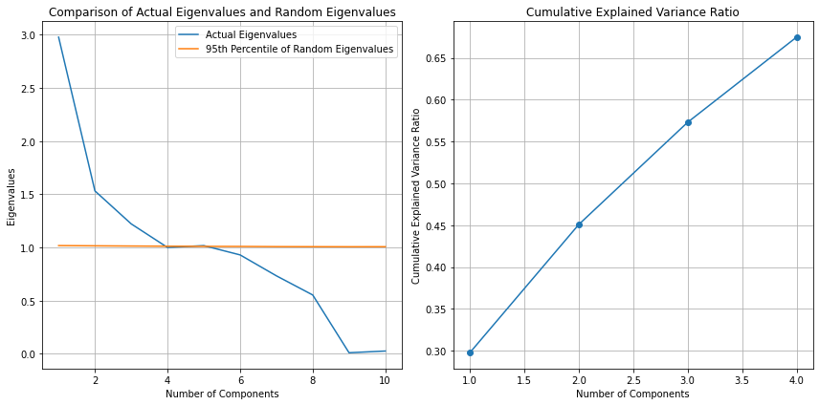

PCA – PARALLEL ANALYSIS
$$n$$
Retain 4 principal components
Cumulative explained variance ratio: 67.48% < 80%
PCA will not be used
Visualization of Parallel Analysis Results

Slide 24
The pipeline
Original data
Cleaned dataset
Data imputation
PCA
Model fitting
Model evaluation
Logistic Regression
Random Forest
KNN
Boosting

Slide 25
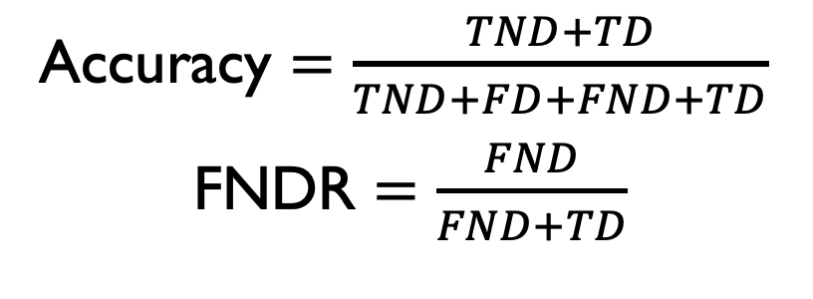
EVALUATION Metric – Confusion Matrix
Response variable:
1: Non-Default
0: Default
Accuracy $=\frac{TND+TD}{TND+FD+FND+TD}$
FNDR $=\frac{FND}{FND+TD}$
True Non-Def (TND) | False Def (FD)
False Non-Def (FND) | True Def (TD)
1
Actual
0
1
0
Predicted

Slide 26
EVALUATION Metric – AUC ROC
Commonly used metric for evalutaion
ROC: Receiver Operating Curve
AUC: Area Under Curve
Graphical representation of true positive rate against false positive rate
AUC score of 1 represents perfect classification, score of 0.5 represents random classification

Slide 27
Logistic Regression – Method
Logistic regression is a statistical method used for binary classification tasks, where the response variable (SeriousDlqin2yrs) is categorical and has only two possible values (0/1).
It estimates the probability that a given observation x belongs to one of the two categories based on exploratory variables.
MODEL ASSUMPTIONS
Absence of multi-collinearity
No extreme outliers
Independence of observations
Linearity in the logit

Slide 28
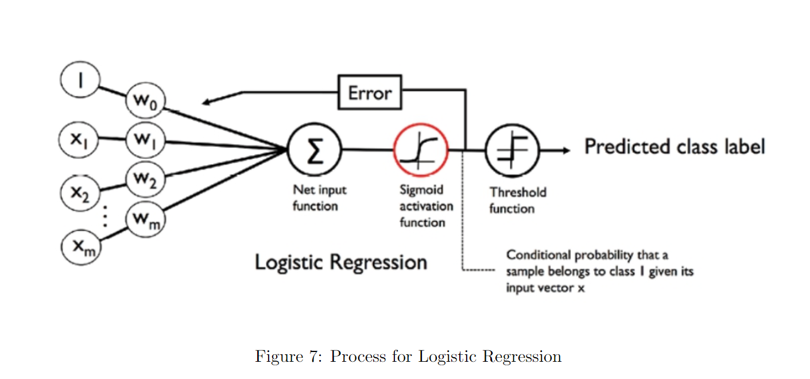
Logistic Regression – Method

Slide 29
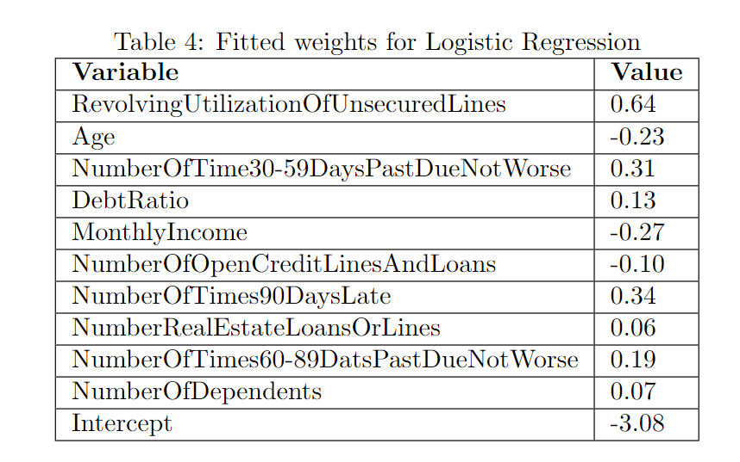
Logistic Regression – RESULTS
The magnitude and sign of the weight indicate the strength and direction of the relationship.
RevolvingUtilizationOfUnsecuredLines has the greatest positive weight (0.64), this suggests that an increase in this ratio is associated with a higher likelihood of default
MonthlyIncome has the lowest negative weight (-0.27), this suggests the higher the monthly income the lower likelihood of default
Influential: RevolvingUtilizationOfUnsecuredLines, NumberOfTimes90DaysLate, NumberOfTime30-59PastDueNotWorse

Slide 30
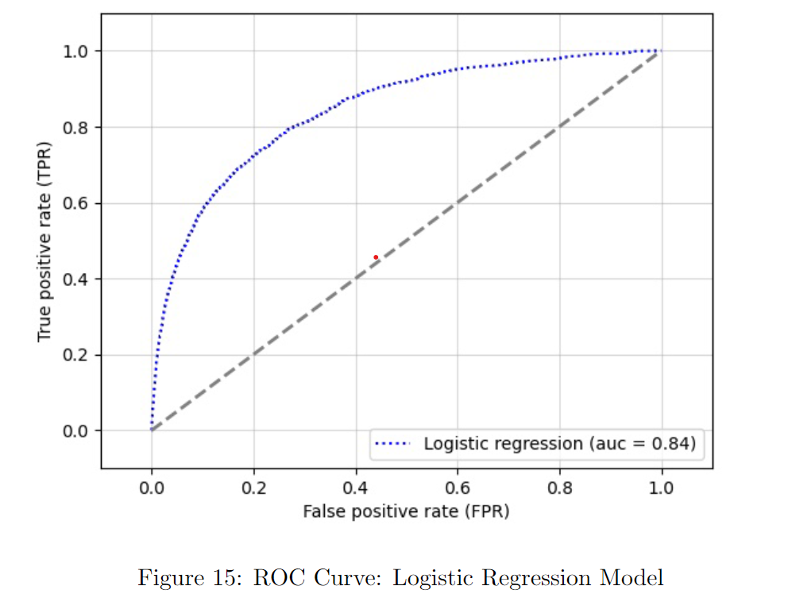
Logistic Regression – Results
Confusion Matrix for Logistic Regression
20477 | 151
1368 | 226
True
Predicted
TND | FD
FND | TD
True
Predicted

Slide 31
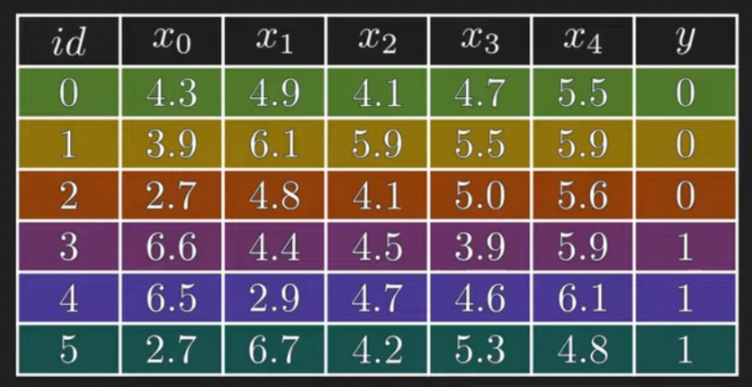
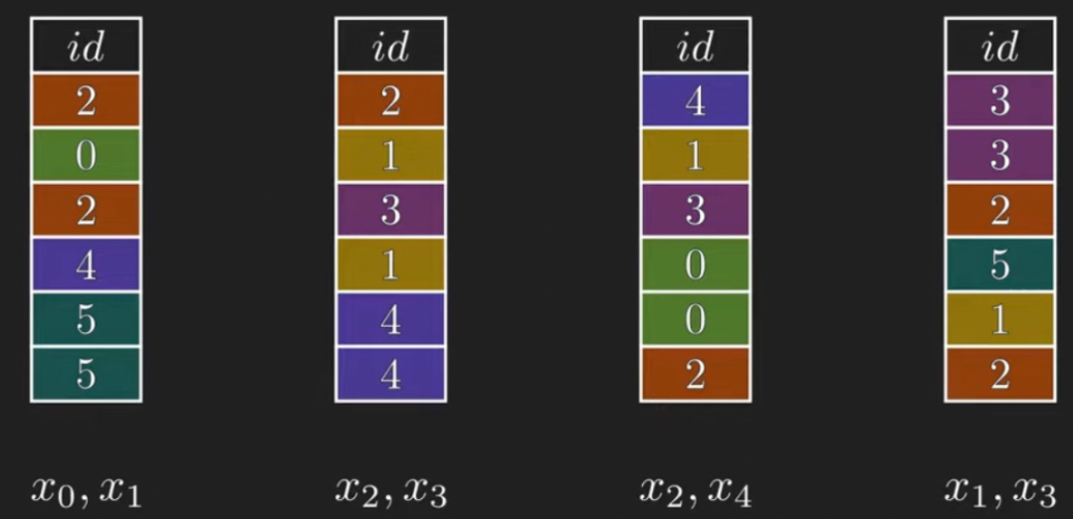
Random Forest – method (Forest of Decision Tree)
Original Data
Sample
colsample_bytree = 2
subsample = 6

Slide 32
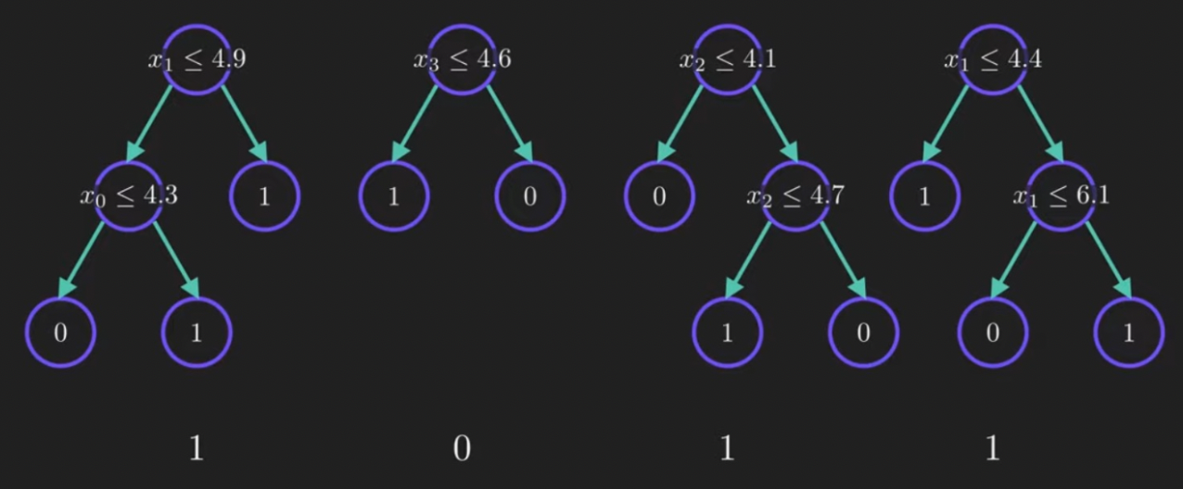
Random Forest – method (Forest of Decision Tree)
Sample
Fitted Trees
Max_depth = 3

Slide 33
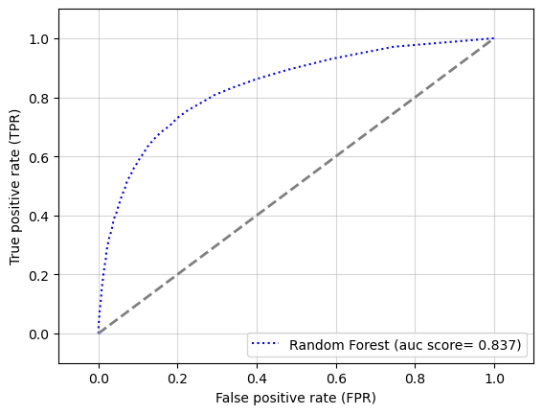
Random Forest – results
Confusion Matrix for Random Forest
20434 | 194
1335 | 259
True
Predicted
TND | FD
FND | TD
True
Predicted

Slide 34
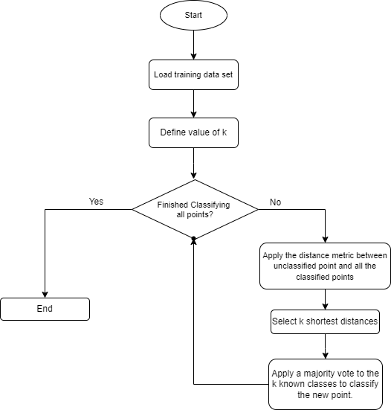
KNN – method
In practice, given a new unclassified point, KNN takes the k most similar data entry points. Identifies the classification of them, then takes a majority vote to determine the class of the new point.
Parameters
The optimal value k = 4, was determined using a gird-search method,
The distance metric used was the Euclidean norm.

Slide 35
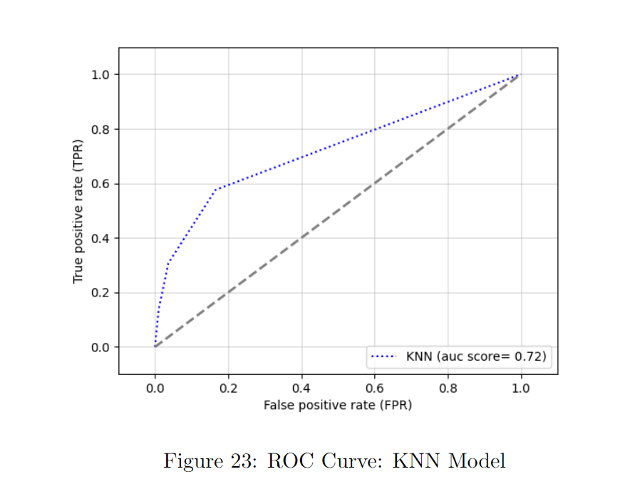
KNN – results
Confusion Matrix for KNN
20401 | 206
1393 | 222
True
Predicted
TND | FD
FND | TD
True
Predicted

Slide 36
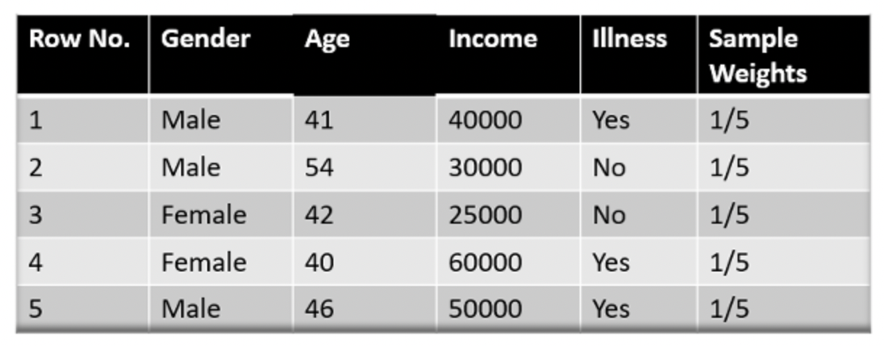
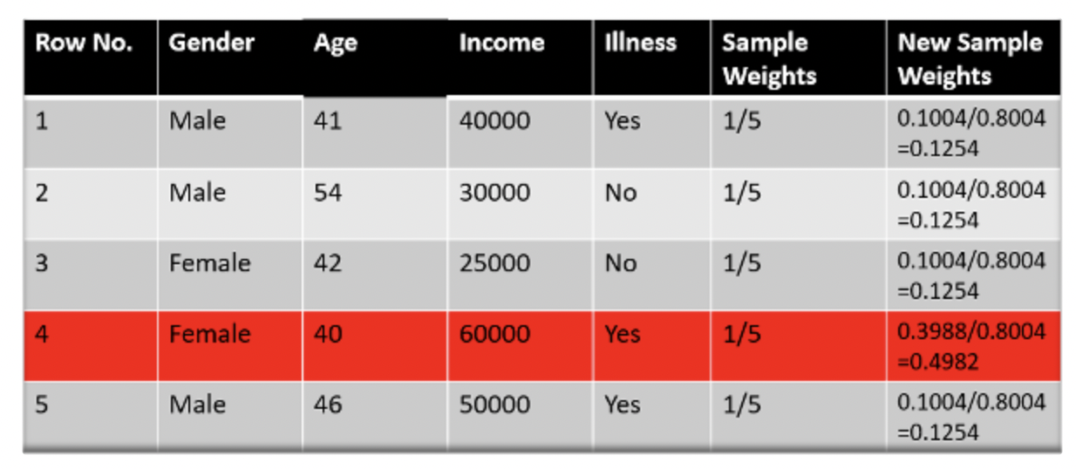
Ada BOOSTing – Method
Step 1: Assign Sample Weights
Step 2: Assign New Sample Weights
(to be explained later)

Slide 37
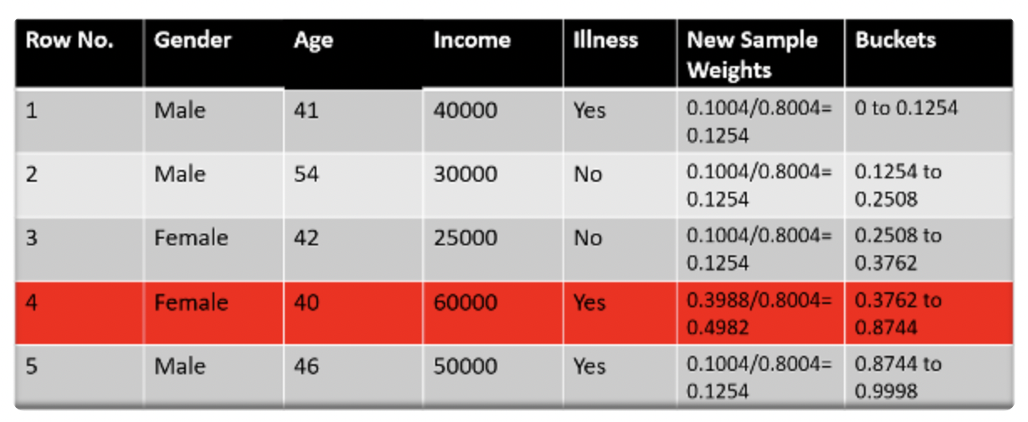
Ada BOOSTing – Method
Step 2: Assign New Sample Weights
(to be explained later)
Step 3:Divide into Buckets

Slide 38
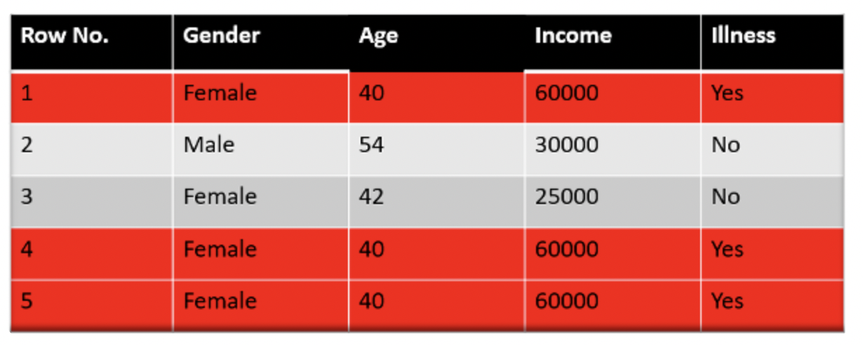
Ada BOOSTing – Method
Step 3:Divide into Buckets
Step 4:Set new dataset Based on bracket
Random Number taken: 0.38,0.26,0.98,0.40,0.55

Slide 39
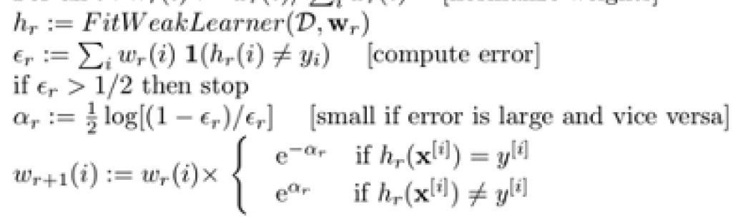


Ada BOOSTing – Weight Assigning
1
2
3
4
1
$h_{r}$: Decision Stump: Decision Tree with Max_Depth = 1
2
$ε_{r}$: Error rate
3
$α_{r}$: Infulence
4
Update weight

Slide 40
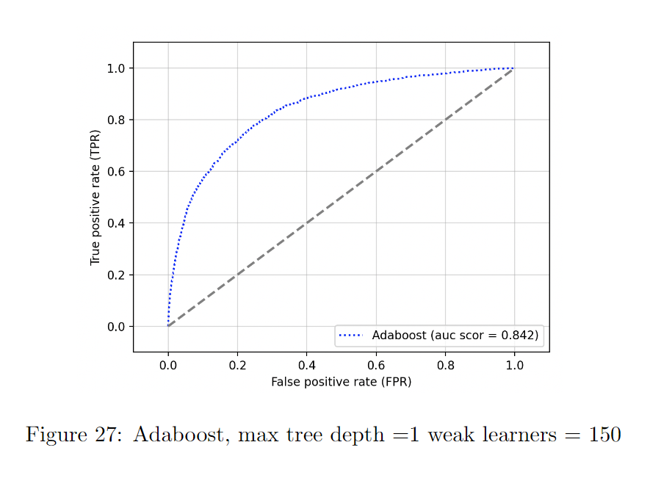
Boosting – RESULT
Confusion Matrix for Boosting
20473 | 163
1351 | 235
True
Predicted
TND | FD
FND | TD
True
Predicted

Slide 41
Model Evaluation – Comparison
Model | Accuracy | Recall | FNDR | AUC
Logistic Regression | 93.16% | 99.27% | 85.82% | 0.840
KNN | 92.80% | 99.00% | 86.25% | 0.720
Random Forest | 93.11% | 99.06% | 83.75% | 0.837
AdaBoost (150 weak learners) | 93.19% | 99.21% | 85.18% | 0.842
AdaBoost (500 weak learners) | 90.01% | 95.13% | 75.05% | 0.760
Gradient Boosting(150 weak learners) | 93.06% | 99.55% | 90.69% | 0.846
Gradient Boosting(500 weak learners) | 89.50% | 94.41% | 73.75% | 0.692
Null Model | 49.28% | 92.63% | 93.15% | 0.512

Slide 42
CONCLUSION
Which variable is the most important in prediction?
Logistic regression weight: Revolving UtilizationOfUnsecuredLines (0.64)
Which model should lenders use for prediction?
Reducing the False Non Default Rate
Gradient boosting (500 learners)
Identifying important attribute
Logistic regression
Maximise loans given to customers
Gradient boosting (150 learners)
Suggested further work

